Slide 1
Geospatial Python
Alex Marden, PhD
GIS and Geospatial Data Coordinator | UT Austin Libraries

Slide 2
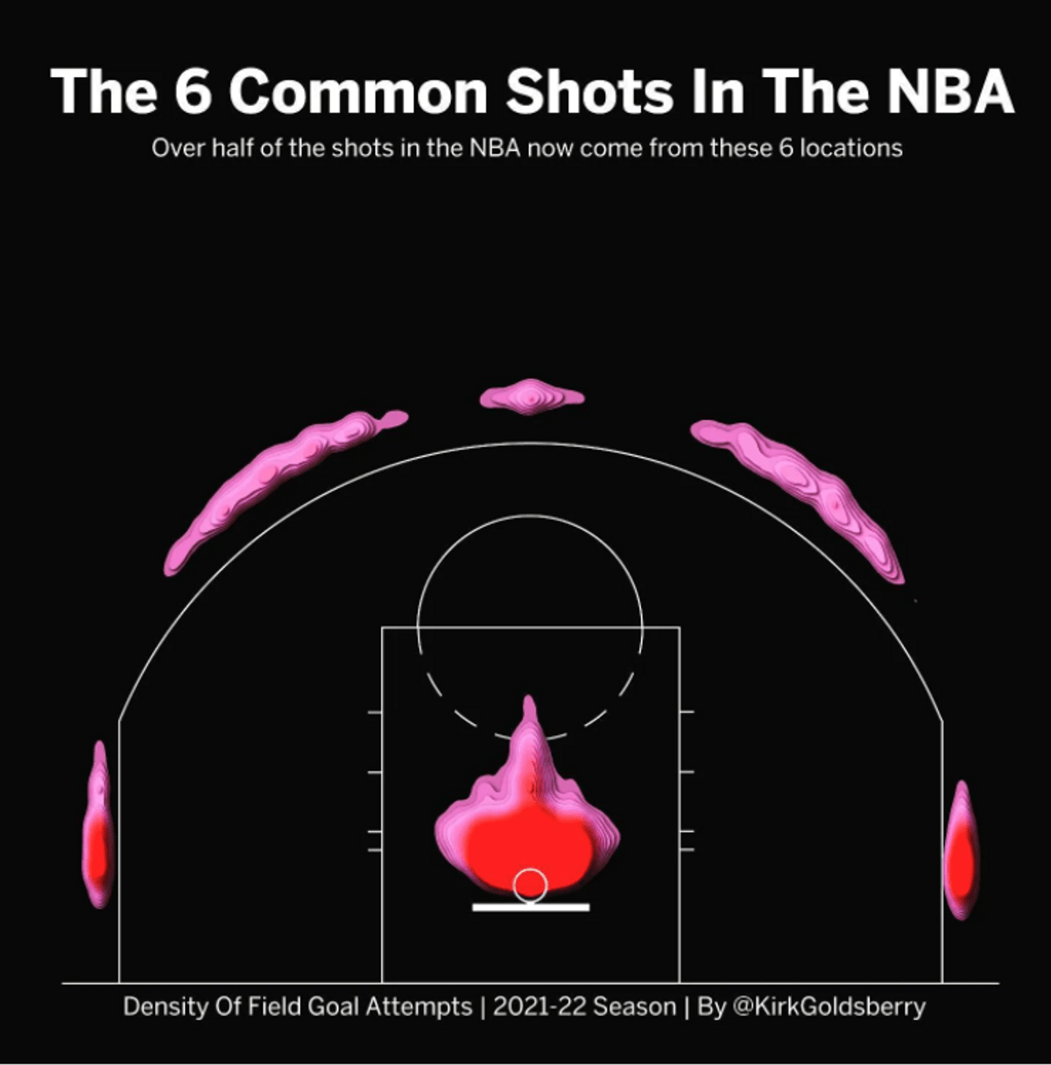
What makes this a map?

Slide 3
What is geospatial?

Slide 4
What is geospatial?
Relates to a specific location on the Earth’s surface

Slide 5
What is geospatial to a computer?

Slide 6
Let’s start with non-geospatial tabular data
Tabular Data
Tabular Data
Building Name | # of floors | Capacity
Old Main | 4 | 456
Corner Room | 1 | 120
Bryce Jordan Center | 12 | 19,874
Y: Capacity
X: Number of floors

Slide 7
What is geospatial to a computer?
Tabular Data
Geospatial Data
Building Name | # of floors | Capacity
Old Main | 4 | 456
Corner Room | 1 | 120
Bryce Jordan Center | 12 | 19,874
Building Name | # of floors | Capacity | Lat | Long
Old Main | 4 | 456 | 40.79 | -77.86
Corner Room | 1 | 120 | 40.78 | -77.85
Bryce Jordan Center | 12 | 19,874 | 40.81 | -77.86

Slide 8
The axes are latitude and longitude
Tabular Data
Geospatial Data
Legend
Capcity
100
Y: Capacity
Old Main
Y: Latitude
Corner Room
15000
BJC
X: Number of floors
X: Longitude

Slide 9
What is GIS?

Slide 10
What is GIS?
Geographic – Relates to a specific location on the Earth’s surface
Information – Data that has some value added
Systems – System that performs functions with geographic data

Slide 11
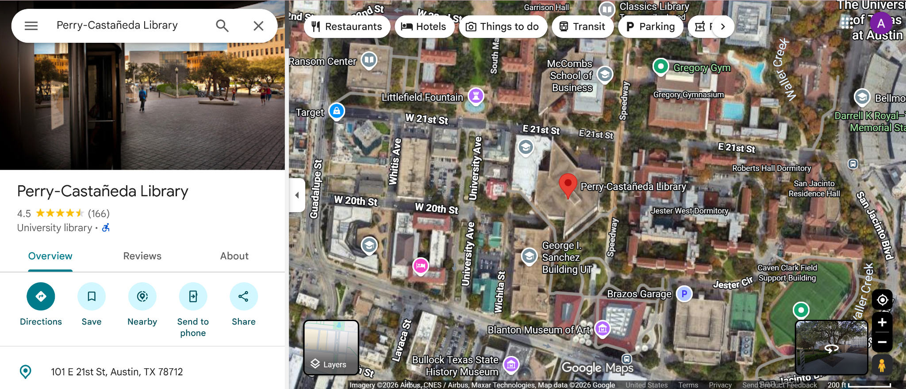
What is GIS?

Slide 12
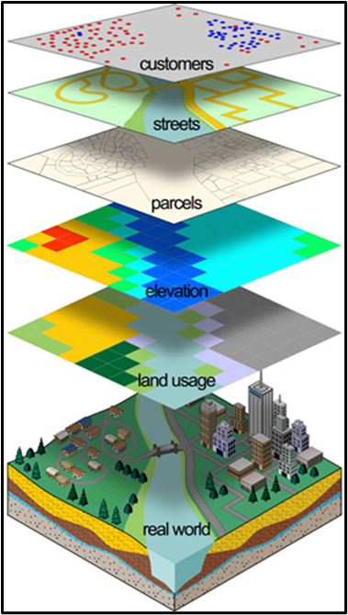
Why is GIS Useful?
Helps answer geographic questions
Location is either used to help find a solution or is the solution itself
Different layers are used to visualize and analyze spatial relationships among variables
“Where did the flooding occur?” “Where should I open my business?”
“Does this redevelopment plan disproportionately impact a certain group of people?”

Slide 13
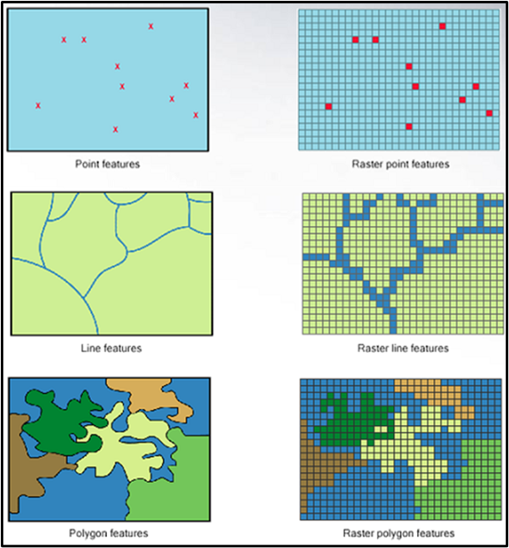
GIS data models
How do we represent geographic space with data?
Two different types of models
Vector
Raster
Vector is normally used for discrete features
e.g., roads, lakes
Raster is best for continuous features
e.g., elevation, land cover type`

Slide 14
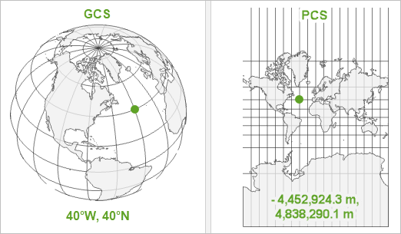
CRS and Projections

Slide 15



GIS Software Overview

